Slide 1

Bird strike analysis
DETAILED PROJECT REPORT

Slide 2
Project details:
Project Title | Data Visualization of Bird Strikes between 2000 – 2011
Technologies | Business Intelligence
Domain | Transportation and Communication
Difficulties level | Advanced

Slide 3
Objective: A bird strike is strictly defined as a collision between a bird and an aircraft which is in flight or on a take-off or landing roll. The term is often expanded to cover other wildlife strikes - with bats or ground animals. Bird Strike is common and can be a significant threat to aircraft safety. For smaller aircraft, significant damage may be caused to the aircraft structure and all aircraft, especially jet-engine ones, are vulnerable to the loss of thrust which can follow the ingestion of birds into engine air intakes. This has resulted in several fatal accidents. Bird strikes may occur during any phase of flight, but are most likely during the take-off, initial climb, approach and landing phases due to the greater numbers of birds in flight at lower levels. To have a closer look the following document visually depicts the data collected on Bird Strikes by FAA between 2000-2011.

Slide 4
Problem Statement:
Transport and communication is one of the crucial domain in field of analytics. Environmental impacts and safety are, nowadays, two major concerns of the scientific community with respect to transport scenarios and to the ever-growing urban areas. These issues gain more importance due to the increasing amount of vehicles and people. Seeking for new solutions is reaching a point where available technologies and artificial intelligence, especially MAS, are being recognized as ways to cope and tackle these kinds of problems in a distributed and more appropriate way.

Slide 5
Dataset information: The Dataset contains only one datafile. It contains information like Record Id: Unique Id for the incidents Aircraft Type: Type of aircraft Aircraft Name: Name of aircraft Altitude Bin: Altitude of aircraft <1000 and >1000 Aircraft make Model: Model number of aircraft Wildlife number struck: Number of wildlife struck in the aircraft Wildlife number struck actual: Actual no. of wildlife struck Effect impact to flight: Effect of impact on flight

Slide 6
Flight Date: Date of flight Effect indicated damage: Whether damage is caused to aircraft or not Aircraft no. of Engines: No. of engines in aircraft Aircraft Airline Operator: Name of airline operator Origin State: Origin state for the aircraft When phase of flight: Phase of flight Conditions Precipitation: Remains of Wild Life Collected: Whether wild life remains collected or not Remains of Wild life send to Smithsonian: Whether wild life remains sent to Smithsonian

Slide 7
Wildlife Size: Size of the wildlife Conditions Sky: Condition of the sky Wildlife Species: Species of the wild life Pilot warned of birds or wildlife: Whether the pilot is warned about the wildlife Cost Total: Total cost incurred due to bird strike incidents Feet above ground: Height of the plane during the incidents Number of people injured: No. of people injured during the incidents Is Aircraft large: whether the aircraft is large or not

Slide 8
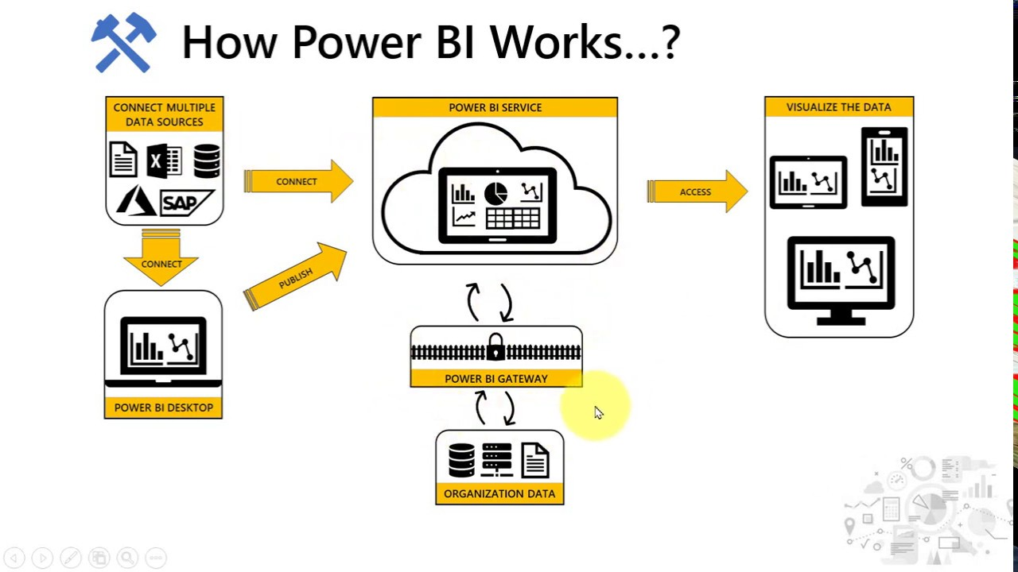
ARCHITECTURE

Slide 9
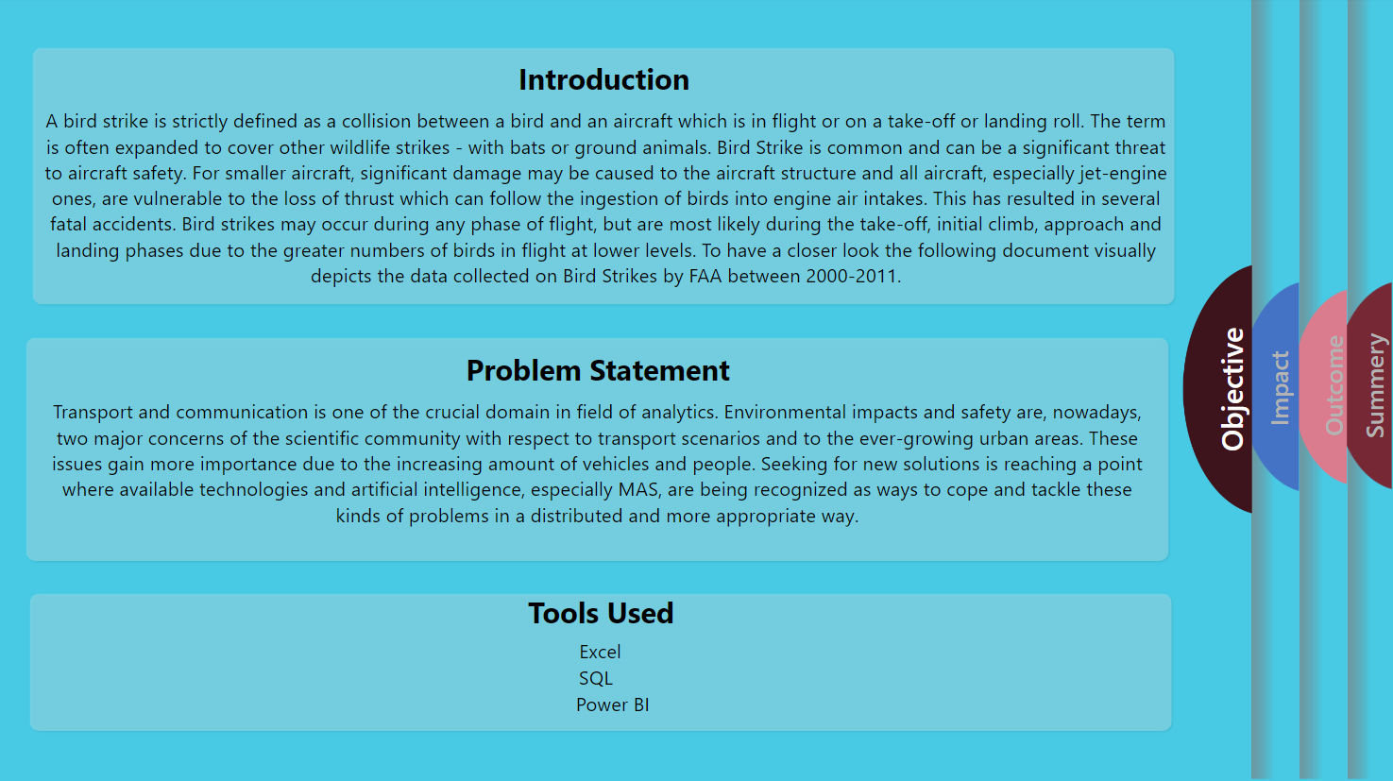
INSIGHTS:

Slide 10
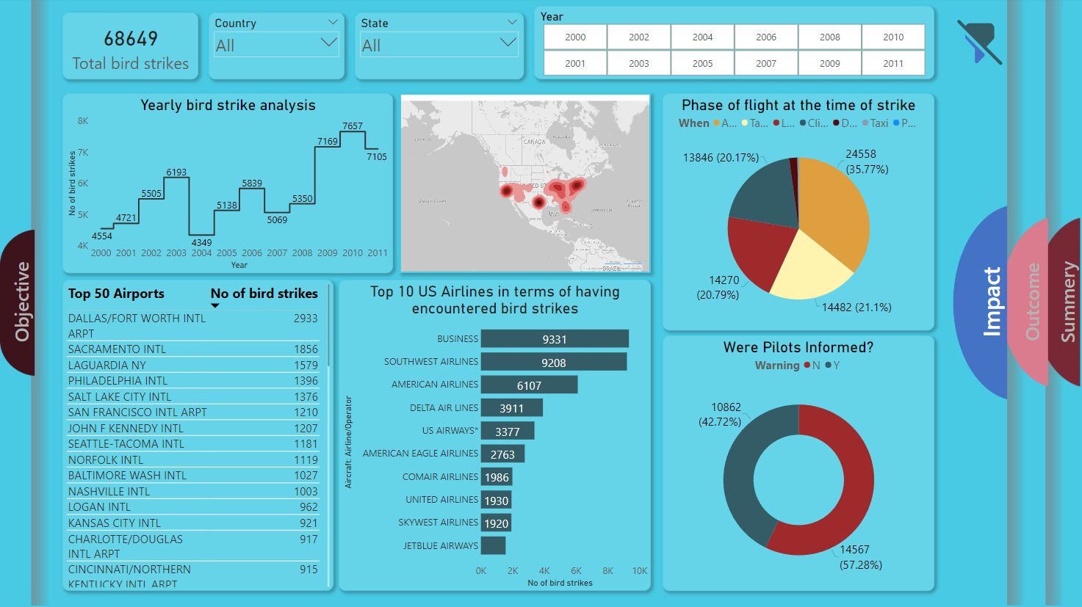

Slide 11
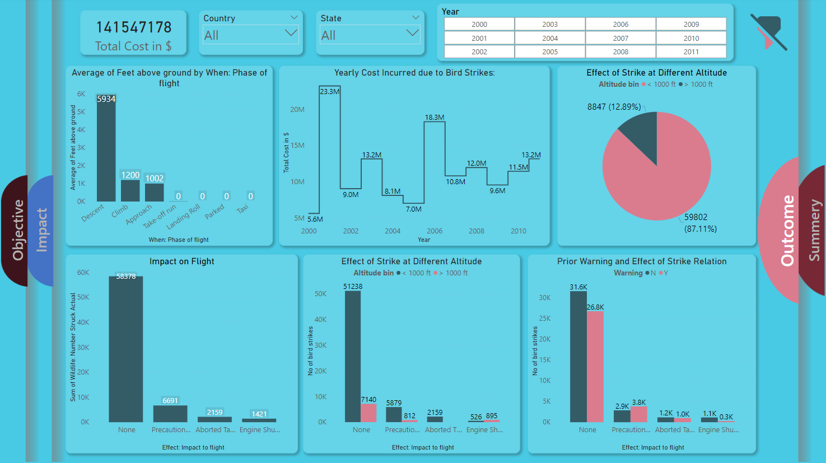

Slide 12
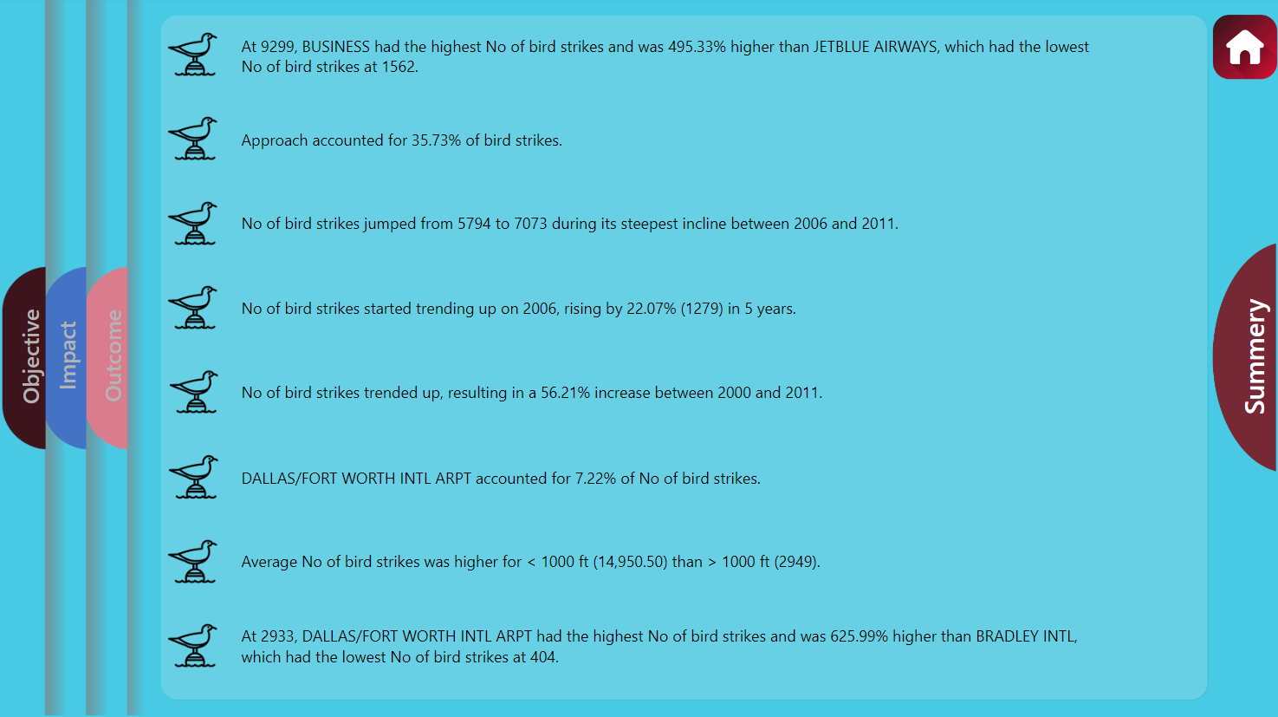

Slide 13
KPI'S:
Total number of bird strike incidents from 2000-2011
Total cost incurred due to such incidents
Impact of warning the pilot on bird strikes
Influence of weather conditions on bird strikes
Influence of altitude at the time of strike
Influence of geographical location

Slide 14
QUESTIONS:
Q1) What’s the source of data?
The dataset is taken from iNeuron.
Q2) What was the type of data?
The data was the combination of numerical and Categorical values.

Slide 15
Q 3) What techniques were you using for data pre-processing?
Removing unwanted attributes.
Visualizing relation of independent variables with each other and output variables.
Checking and changing Distribution of continuous values.
Removing outliers.
Replacing null values.

Slide 16
Thank you

